Slide 1

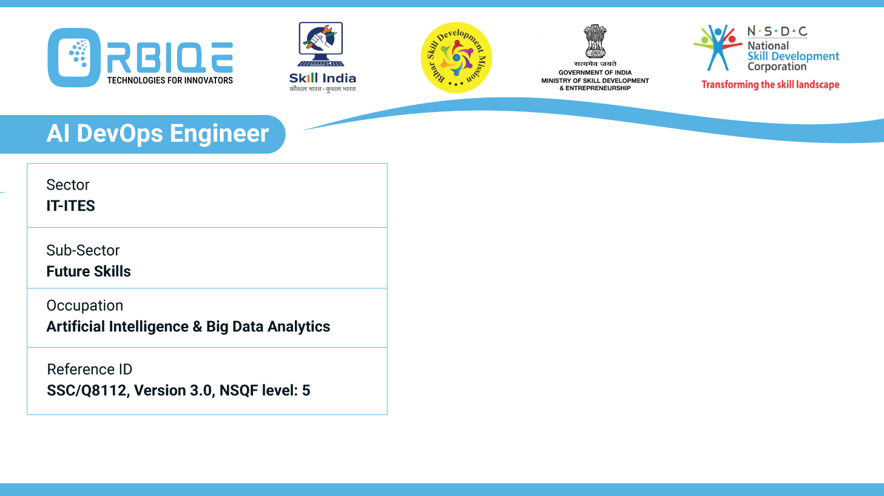
Name- Krishna Kant Dubey

Slide 2

Variations in CI/CD Pipeline for Different Products

Slide 3
Agenda
Pipeline for Desktop Applications
Pipeline for Mobile Applications
Pipeline for Web Applications

Slide 4
Pipeline for Desktop Applications

Slide 5
Pipeline for Mobile Applications

Slide 6
Pipeline for Web Applications

Slide 7
Thank You

